Slide 1




Slide 2
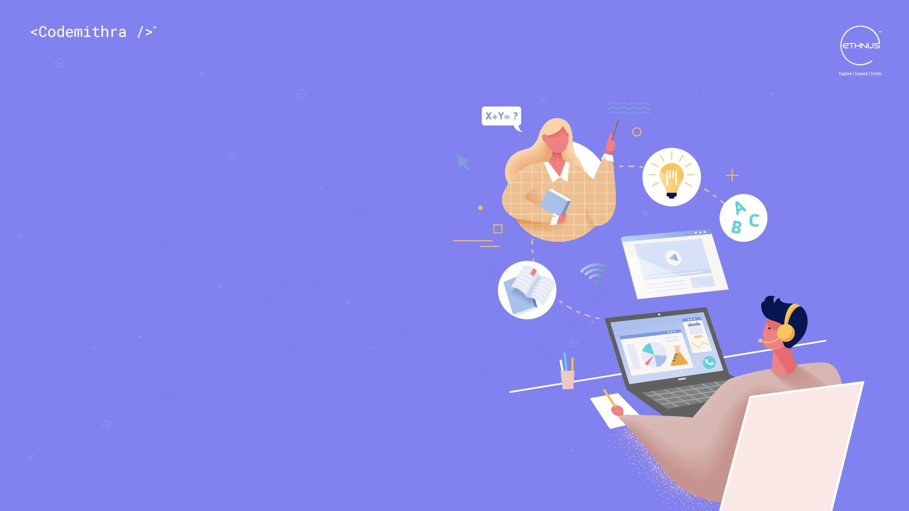
CUSTOMER
CENTRICITY-1.2

Slide 3
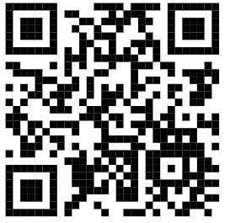
TEST TIME ON PERMUTATION AND COMBINATIONS-2
QR CODE:

Slide 4

CONCEPT
Is ANYONE on your team committing these service sins?

Slide 5
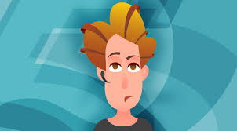
CONCEPTS
1. Apathy - "It's not my problem."
Notes:
Your customers should never get the impression that anyone they come in contact with isn't concerned about their situation. If you are like me, I just hate it when this happens to me.

Slide 6
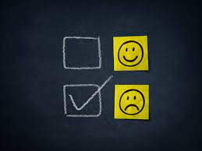
CONCEPTS
2. The Brush-off - "The problem will go away eventually."
Notes:
Avoiding your customer's dilemma won't fix it. All it will do is turn your customer off. Look for unanswered email requests, postponed follow-up calls, and trouble tickets that never seem to close.

Slide 7
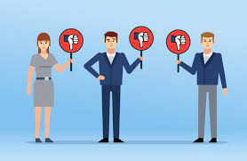
CONCEPTS
3. Coldness - impersonal responses.
Notes:
No matter how many times the same customer calls, he/she deserves your attention and warmth. Even on the phone, a smile conveys welcome.

Slide 8
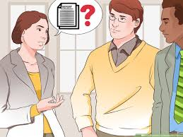
CONCEPTS
4. Condescension - treating customers like incompetent children.
Notes:
More times than not, service calls are for rudimentary problems. Sure, they're obvious to you, but not to your customers. No matter how many times you answer the same questions, be patient and respectful.

Slide 9
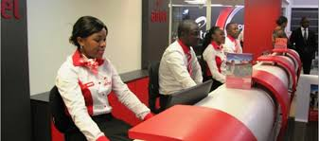
CONCEPTS
5. Robotism - "Is that all- have a nice day- bye bye." or "That is not a problem"
Notes:
Great customer service is individualized. No one wants to be just another account. Offer your customers more than the bare minimum. And remember, people buy from people--don't be afraid to let them know you're a living, breathing human.

Slide 10
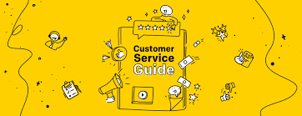
CONCEPTS
6. The Rule Book - inflexibility no matter what.
Notes:
Rules are made to be broken - especially when today's reality has passed them by. Let customers know their business is worth breaking a rule now and then.

Slide 11
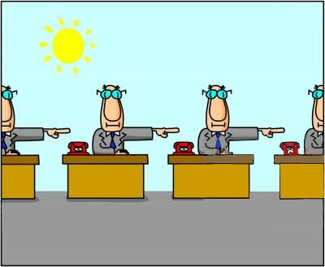
CONCEPTS
7. The Runaround - passing the buck.
Notes:
Whether it's because of a complex voice-mail network or a cumbersome problem-solving process, customers will only tolerate so much bouncing around before they take their business elsewhere

Slide 12
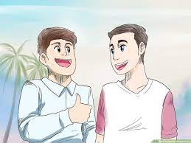
CONCEPTS
8. The False Friend - "I friended you on Facebook. What more do you want?"
Notes:
By itself, quick 'friending' on social media sites does nothing for customer service excellence. Prove yourself a real friend by spending a bit of extra time, going to the next level and delivering service to make your mother proud.

Slide 13

CONCEPTS
1. Risking the safety of a customer/causing injury to a customer.
Notes:
Examples include: leaving unsecured throw rugs and mats on your floors (there’s a reason that “trip and fall” accidents got that name), blocking (or locking) fire exits or obscuring them for aesthetic reasons with curtains, pulling the batteries out of your smoke detectors “because that beep was annoying”, fudging the details of your renovation plans so that you don’t have to install fire sprinklers (fire sprinklers are incredibly important, almost 100% effective life savers whose importance we saw in both London–sadly–and the Bronx–happily–already this summer)

Slide 14
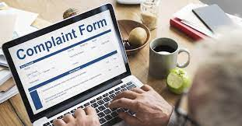
CONCEPTS
2. Threatening your customer with a lawsuit for honest but unflattering commentary online.
Notes:
This is rude, doesn’t work, and is likely to bring more, rather than less, unwanted publicity, due to the workings of the Streisand effect.

Slide 15
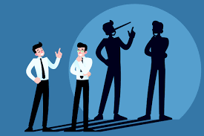
CONCEPTS
3. Lying to a customer.
Notes:
Not only is this philosophically wrong, it’s likely a strategic error as well, even if the truth never comes out; even if you get away with your lie as far as customers are concerned, the people who work with you will nonetheless learn the wrong example and get demoralized by overhearing your lies.

Slide 16
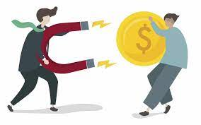
CONCEPTS
4. Stealing from a customer.
Notes:
This includes pocketing a windfall that really calls for a customer credit.

Slide 17
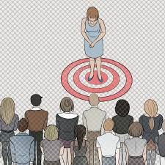
CONCEPTS
5. Bullying your staff.
Notes:
This is immediately damaging if done in view or earshot of a customer, but it’s essential that it not happen behind the scenes either. The effect on customers due to employee demoralization will bring down your entire organization in the end.

Slide 18

CONCEPTS
6. Racism, sexism, and class-based stereotyping.
Notes:
Remember: that sloppily dressed guy with the backwards-facing baseball cap may be a billionaire or a famous blogger; regardless, she or he’s a customer or potential customer, and deserves to be treated as such.

Slide 19

CONCEPTS
7. Being hostile to providing accommodations for customers with disabilities.
Notes:
This includes fudging the details of your renovation proposal so you don’t have to bring your business up to compliance; it also includes grudgingly following ADA requirements but then failing to have clear directional signage that makes the ADA setup usable to a newly-arrived customer; it includes failing to train your staff in how to serve customers with disabilities; and it includes being negative behind the scenes (but where employees can hear you) about the challenges of serving customers with disabilities.

Slide 20

CONCEPTS
8. Belittling a customer
Notes:
(“Well, that’s wrong. You should have…”); arguing with a customer, even if “he started it;” not saying “I’m sorry” when the situation is really your fault; not living up to a promise given even if made by someone else in the organization

Slide 21
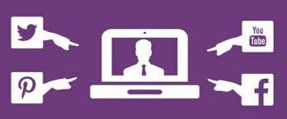
CONCEPTS
9. Shaming a customer by posting your account of an incident on social media.
Notes:
(You’d think this would be obvious, but this does happen, usually when someone at a company has had a long day and too many drinks after a shift.)

Slide 22




THANK YOU
+91 78150 95095
codemithra@ethnus.com
www.codemithra.com

